Slide 1

SOFTWARE DEVELOPMENT PROJECT Based on the course CSE 300
A Productive Browser Extension
to utilize browsing time more effectively and efficiently

Slide 2

A Productive Browser Extension
Presented by:
Name: SADIA ISLAM SAMI | Roll: 16102018 | Reg: 4870 .
Name: ASHIKUZZAMAN | Roll: 16102020 | Reg: 4872 .
Supervised by:
Prof. Dr. Md. Mijanur Rahman
Dept. of Computer Science and Engineering

Slide 3

outline
Introduction
Objective
System Design and Development
Diagrams
Result and Discussions
Limitations
Future scope
Conclusion
3

Slide 4

Introduction

Slide 5

Introduction
Internet
Browser
Browser Extension
Cross plate form
Authentication
To do task manager
Remainder
Favorite site
5

Slide 6

history
History of Browsers: Web browsers started their journey with NCSA Mosaic(1993), right after that Internet Explore launched on 1995 which create the completion on this sector on base of feathers. From there continuous browsers are coming with best public demand new features as like as: Opera(1996), Firefox(2004), Chrome(2008).
History of Extensions: Internet Explorer was the first major browser to support extensions, with the release of version 5 in 1999. Firefox has supported extensions since its launch in 2004. Opera began supporting extensions in 2009, and both Google Chrome and Safari did so the following year. Microsoft Edge added extensions in 2016.
6

Slide 7

Objective
To design and develop a smart browser extension for web browsers.
To demonstrate several activities of extensions, such as, to-do list, demand tasks, statistics, favorites, time, weather, location, etc..
7

Slide 8
Background study
We have done a study on several browsers and their extensions. The three most popular desktop browsers are Chrome, Firefox and Microsoft Internet Explorer (in June 019).
8

Slide 9

System Design and Development

Slide 10
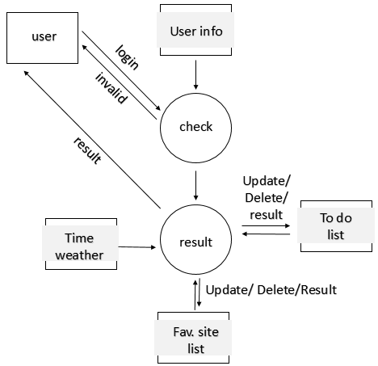
Data flow diagram:
10

Slide 11
E-R Diagram
11

Slide 12
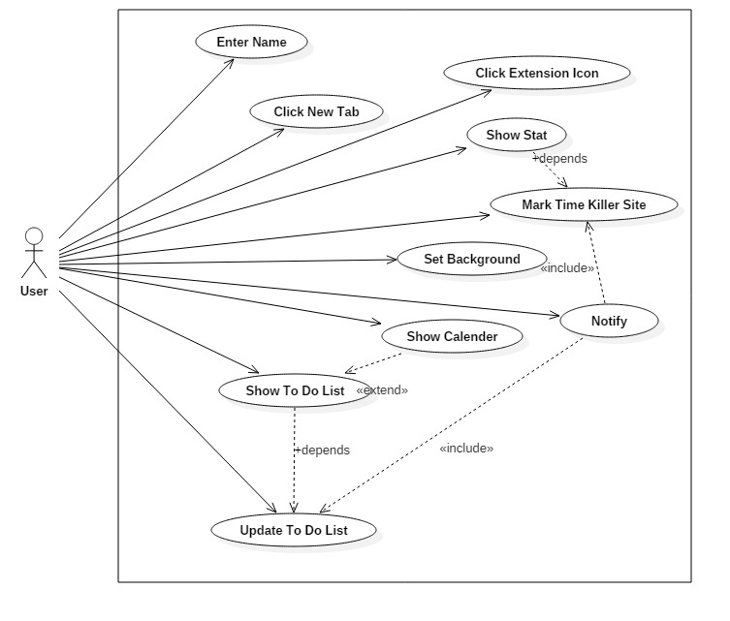
User case diagram
12

Slide 13
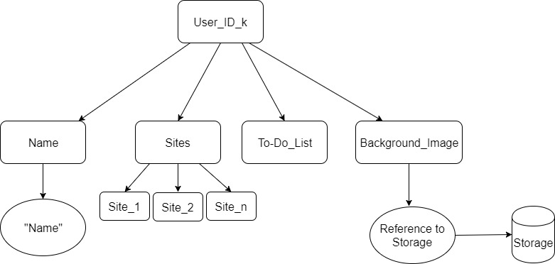
Database tree diagram
13

Slide 14
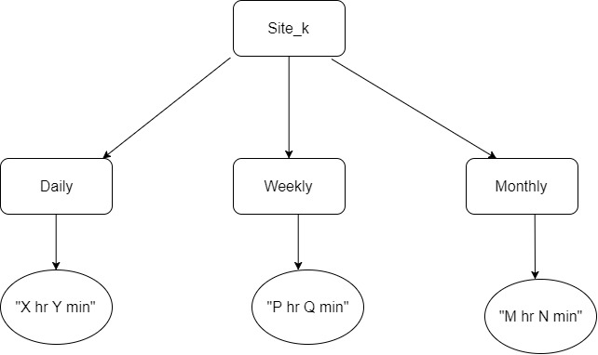
Database tree diagram
14

Slide 15
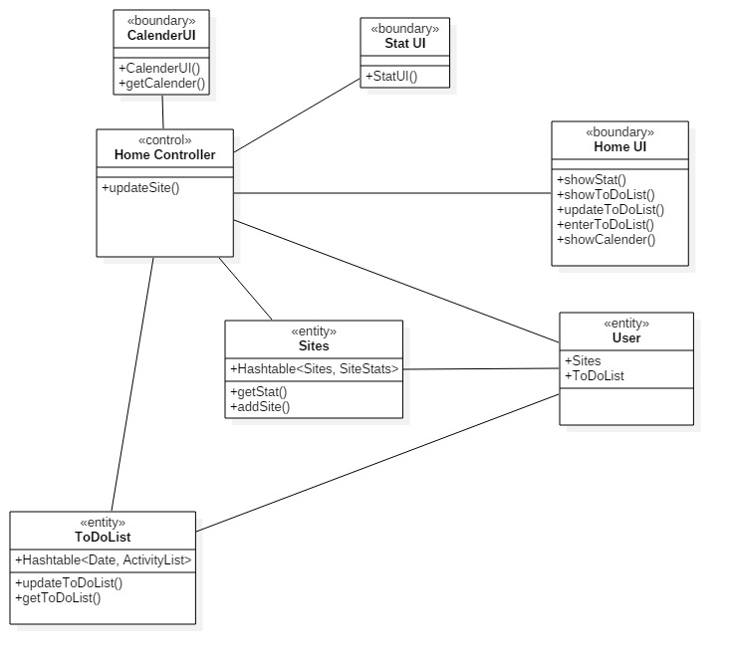
Class diagram
15

Slide 16
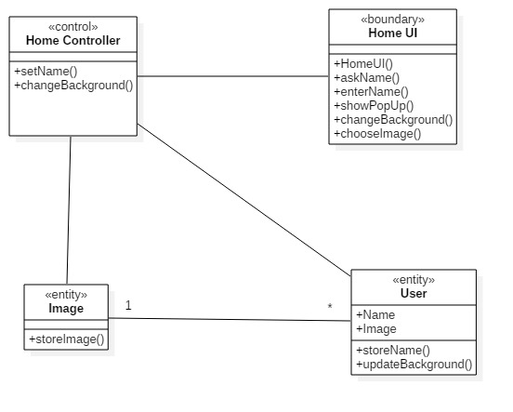
Class diagram
16

Slide 17
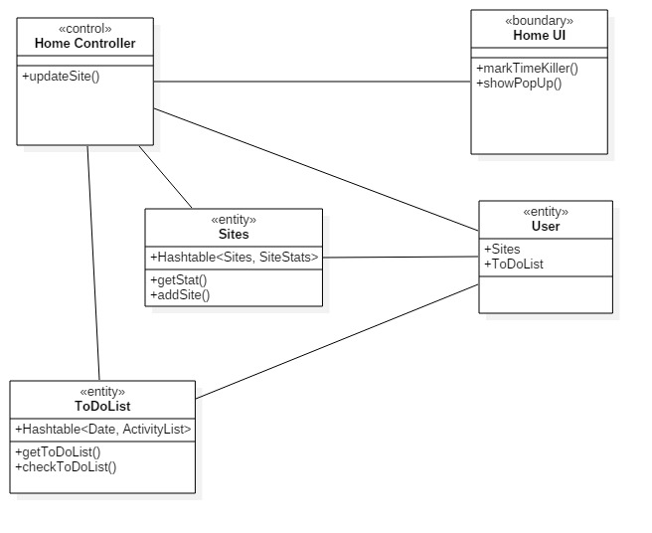
Class diagram
17

Slide 18
Programming Language
HTML
CSS
JAVASCRIPT
JSON
Firebase
18

Slide 19

Results and Discussions

Slide 20
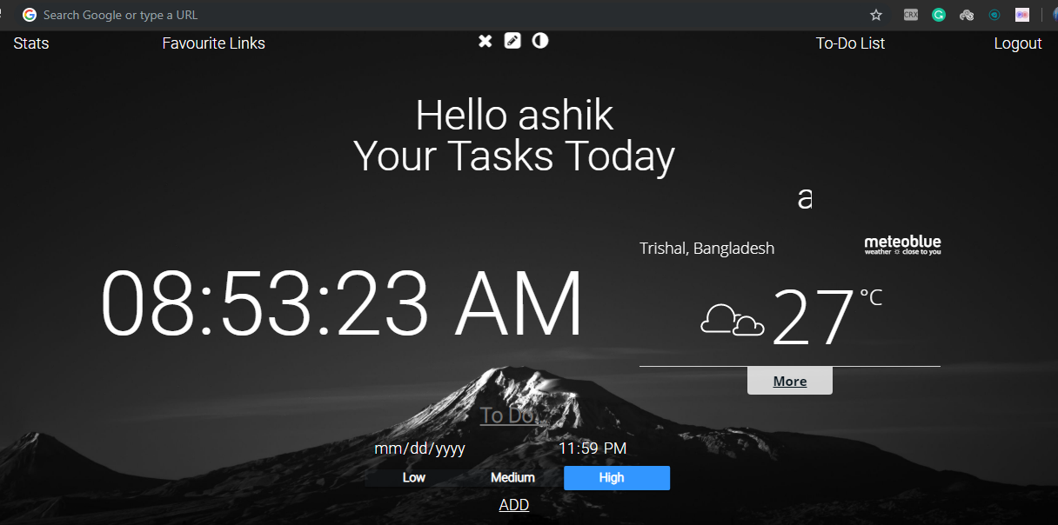
results
Home: Home is loaded with services such as favorite link, stats, to do list, log in-out, clock, weather and some personal customizations.
20

Slide 21
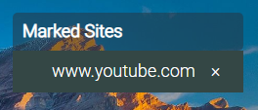
results
Stats: State creates the statistics of marked sites browsing.
Favorite Links: Mark favorite sites for easy access and save them.
21

Slide 22
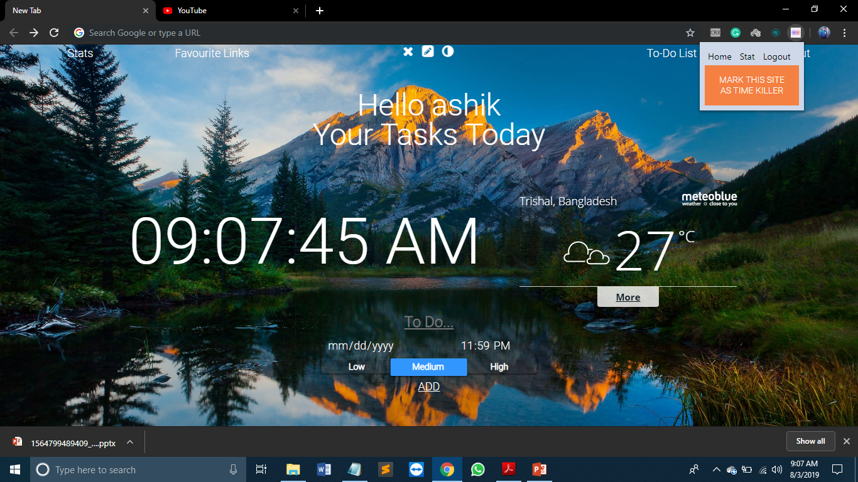
results
To Do: Add tasks with priority, date and time and get remainder .
Icon: Create popup functions,
go to stat, home, logout and mostly mar time killing sites.
22

Slide 23

Limitations
This extension is having a problem with secure authentication with less verification, manage database organically, multiple log in to same id and ad blocker disable extension some times.
23

Slide 24

Future Scope
We have a plane to publish this extension on web store so need to solve authentication problem with two level verification both work on online and offline data analysis, ad-blocker problem should be remove and applicable multiple log-in access.
24

Slide 25

Conclusion
The aim of this project was to develop a smart extension for browsers. Based on several activities, extension is an important part of a browser.
This is a cross platform extension with authentication verify on real-time database to manage task list with priority, mark websites to generate statics of browsing with showing time and weather.
From the experimental results, it is concluded that the proposed extension can be used in any browser to demonstrate several activities.
25

Slide 26
THE END
A Productive Browser Extension
to utilize browsing time more effectively and efficiently

